Slide 1
Plantera
Farm automation system
Supervised by: Dr/ Mahmoud Abd Alaal

Slide 2
—Audrey Hepburn
“To plant a garden is to believe in
Tomorrow.”

Slide 3
Team members
Osama Mohamed Hussien
Ahmed Muhammad Morsi
01.
04.
Mariam Hossam
Dina Abdallah Muhamad
02.
05.
Osama Sayed Ahmed
Amira Ahmed Khater
06.
Responsible for flutter application and firebase
Responsible for DL plant disease detection model
Responsible for flutter application and firebase
Responsible for ML Model
Responsible for hardware and IOT
Responsible for website and firebase
03.

Slide 4
Table of contents
Project motives
Management plan
01.
03.
Project Proposal
Operating plan
02.
04.
The problem that the project addresses and works toward solving it
Project diagrams and components
Project idea, aims, and importance
Tools and procedures

Slide 5
01
Project motives
Trial to participation in solving some problems that face agricultural sector in Egypt

Slide 6
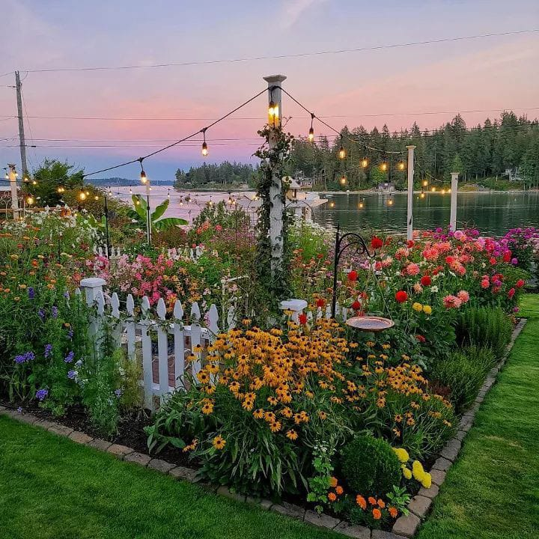
Problem & solution
Problem
Farmers waste a lot of water to irrigate some types of plants.
Some diseases harm a pretty much amounts of plants and farmers may don’t know lately what the disease are
Knowing crop yield produced may affect important decisions
Solution
A system to help farmers reduce consumption and tell when the plants need nutrition or water, detect some diseases of a plant and predict crop yield using technology such as AI and IOT.

Slide 7
02
Project Idea

Slide 8
Project Idea and pillars
Detecting plant diseases
1.
Automating farms
2.
3.
Feedback to the user
Using deep learning model to detect diseases
Using hardware and IOT to automate farms to reduce human effort
Crop Yield prediction model
4.
Creating an application to keep farmers up to date about their farm(s)

Slide 9
Project aims
Reliability
Usability
Simplicity
We aim to be a reliable form of information for our farmers, providing them with correct data, and helpful information.
We aim for a usable system
And easy to use
Reductional
It use a system with a user- friendly application and website.
We aim to reduce the effort done by farmers and do thing by more accurate form

Slide 10
Others in the market plantix and plants
01.
02.
03.
A system that can irrigate plants intelligently only
A system that searches for plant diseases
A system for crop prediction

Slide 11
others
Us
Each solution tries to solve each problem independently
Our goal is to solve more than one problem and integrate it into a broader system that can intelligently irrigate, intelligently detect plant diseases, predict crop yields, and make farmers control the system via a smartphone.

Slide 12
03
Management plan
Project and its components

Slide 13
Project Components
01
02
03
04
IOT irrigation system
Mobile Application
Deep learning and ML models
Website

Slide 14
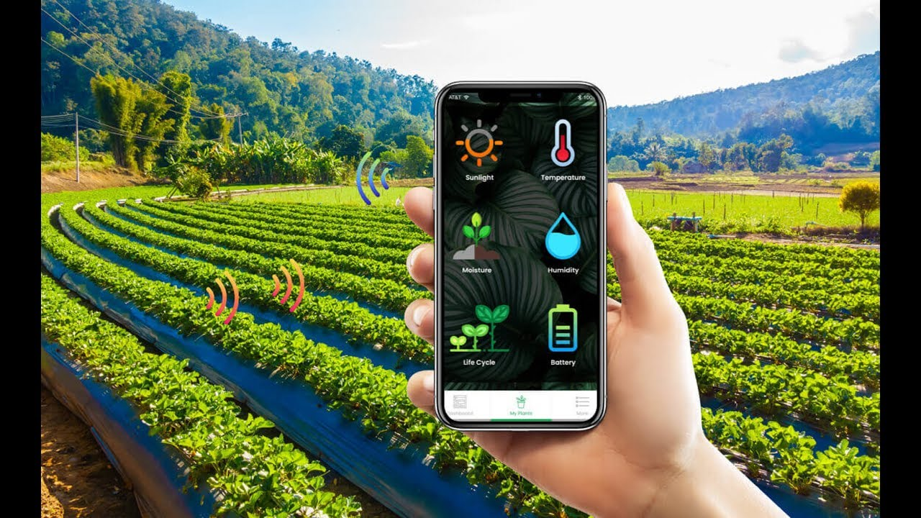
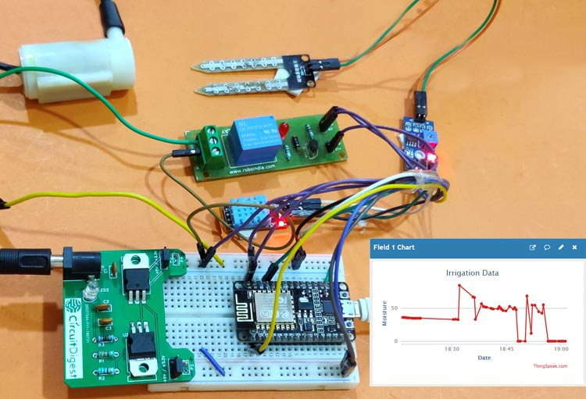
IOT irrigation system

Slide 15
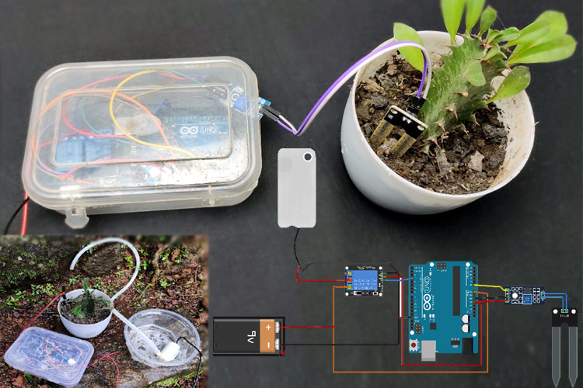
Hardware tools
PH Sensor kit (Water Acidity Measurements)
Soil Humidity Sensor Controller System
Temperature & Humidity Sensor
Rain Sensor
Water pumpL298 Module Red Board
Solar Panel
Lead acid Battery
Solar charge controller
microcontroller Node-Mcu

Slide 16
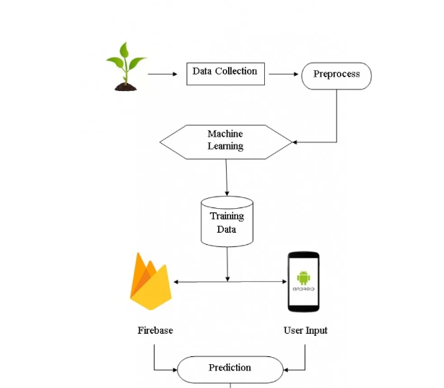
Crop Yield prediction model
Using regression algorithms in ML

Slide 17
Why?
Dataset Used
Yield
Avr_rainfall
Avr_temp
Pesticide
To predict the number of crops produced based on some features

Slide 18
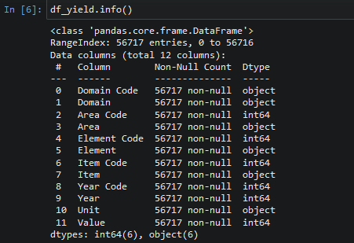
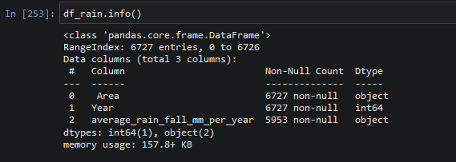
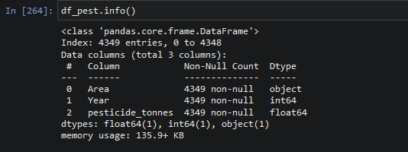
Information about data

Slide 19
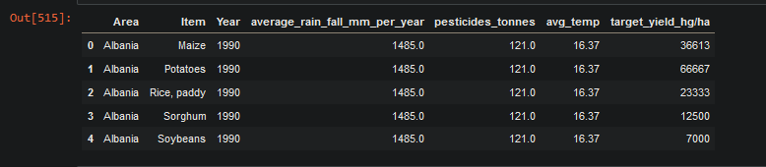
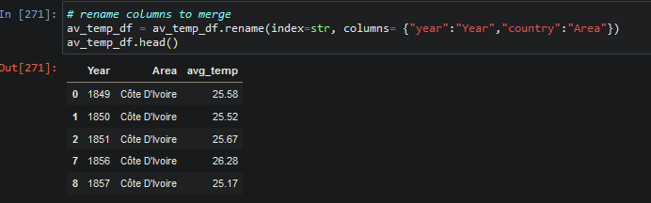
Information about data

Slide 20
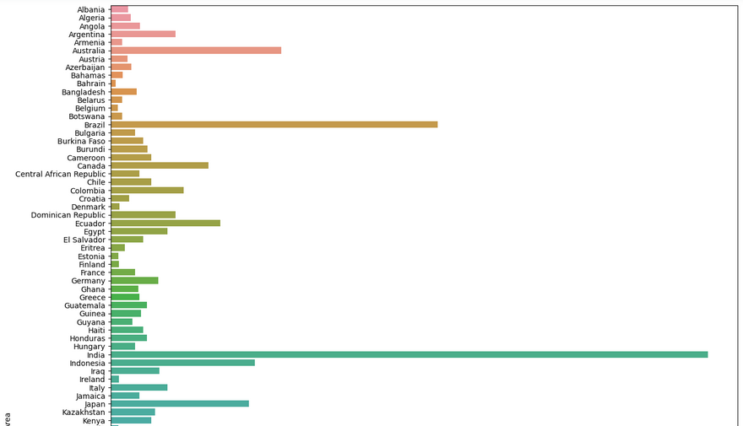
Data Visualization

Slide 21
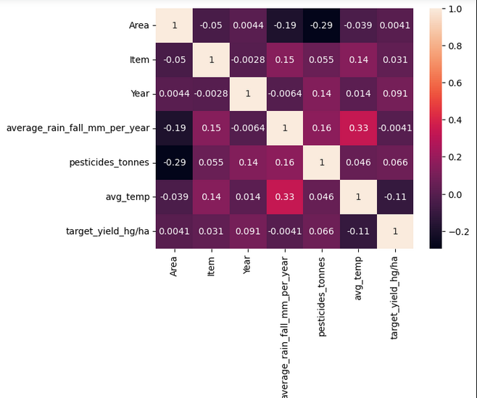
Data Visualization

Slide 22
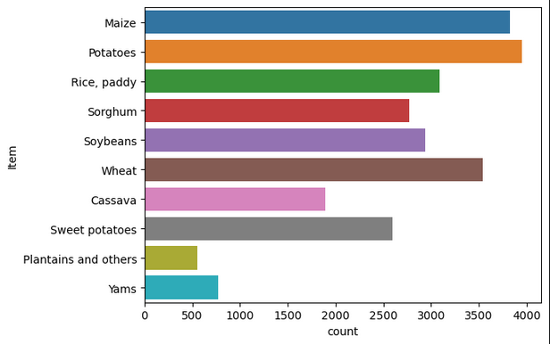
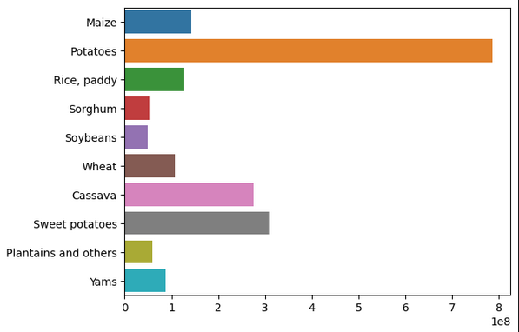
Data Visualization

Slide 23
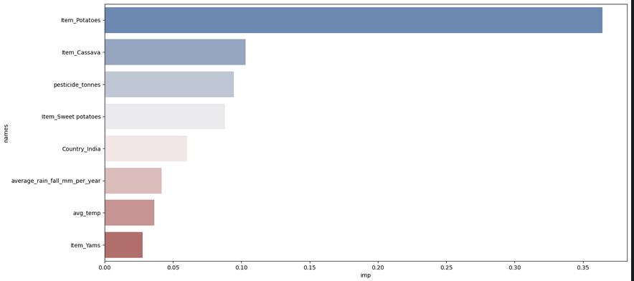
Data Visualization

Slide 24
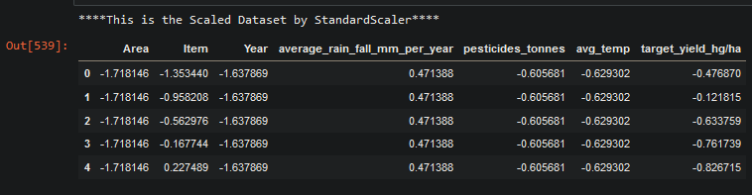
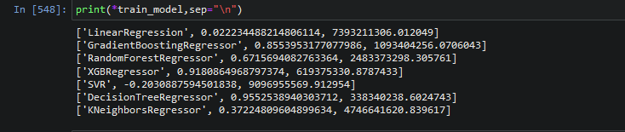
Data preprocessing model building and Evaluation

Slide 25
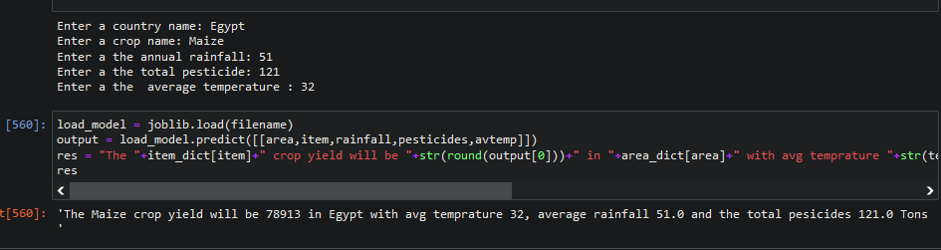
Load best model and test
Decision Tree Regressor

Slide 26
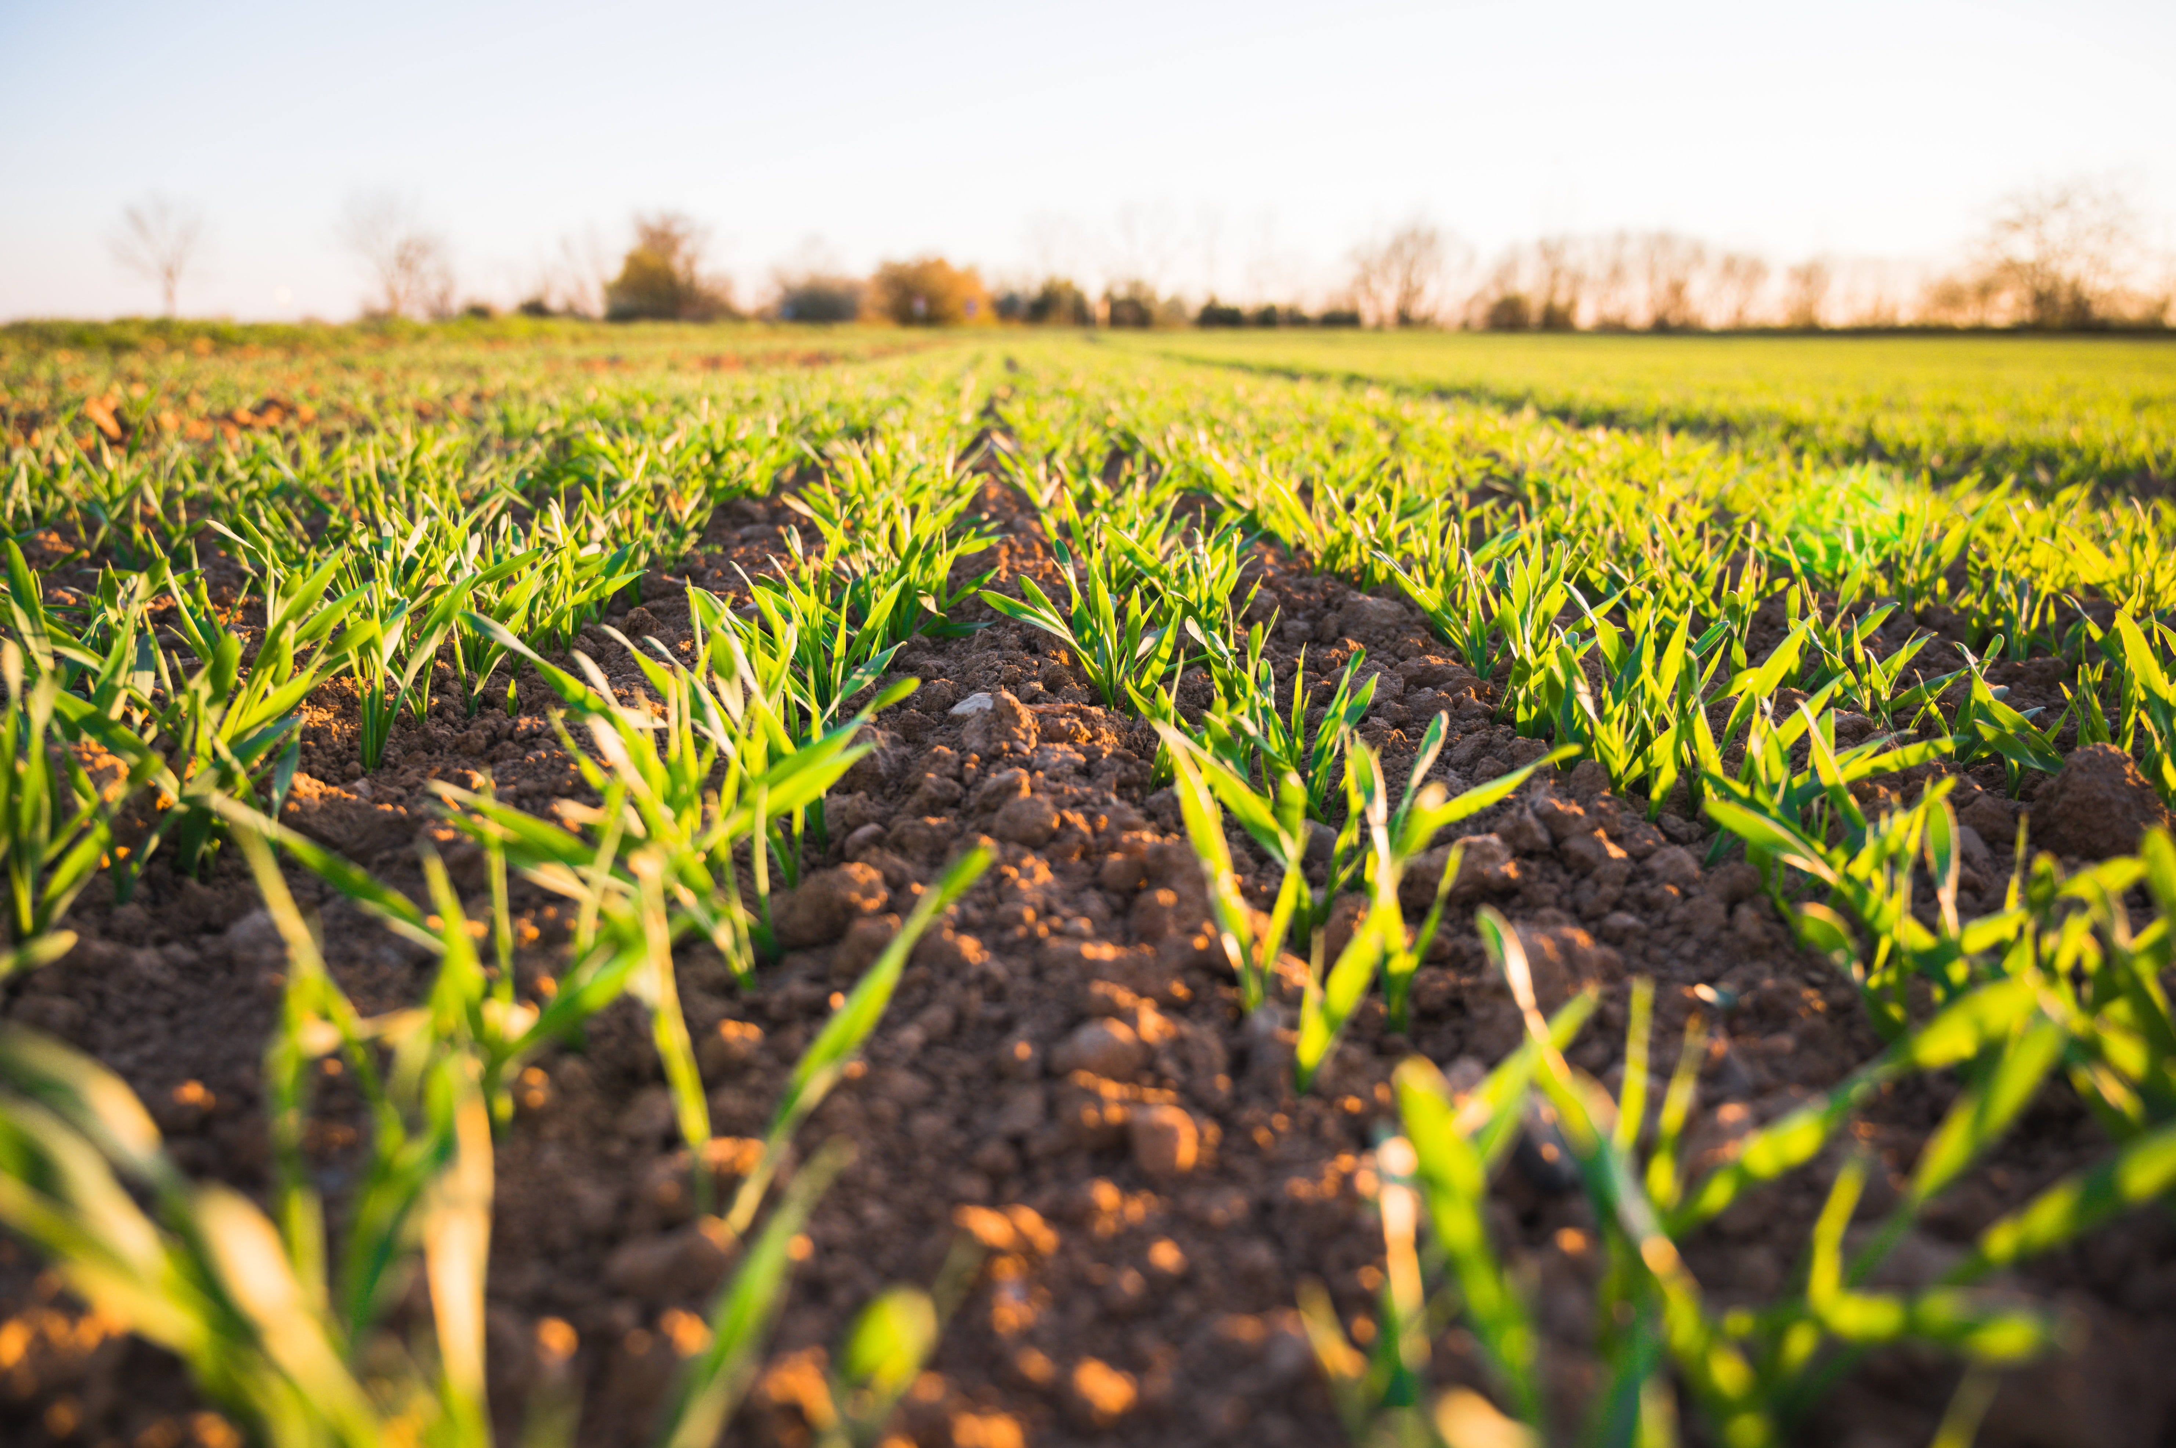
Plant disease detection model
Using pre-trained model for the dataset
Why MobileNet?
The pre-trained model is a saved network that was previously trained on a large dataset typically on large-scale image-classification task

Slide 27
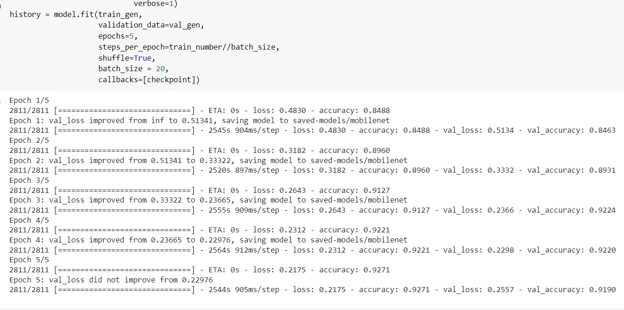
Plant disease model
Dataset training

Slide 28
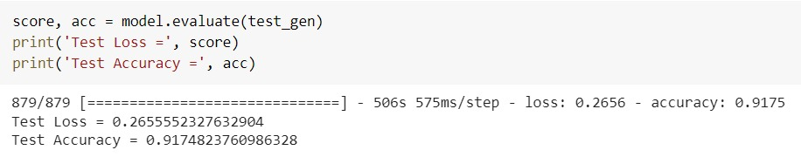
Final plant disease model accuracy
Final accuracy

Slide 29
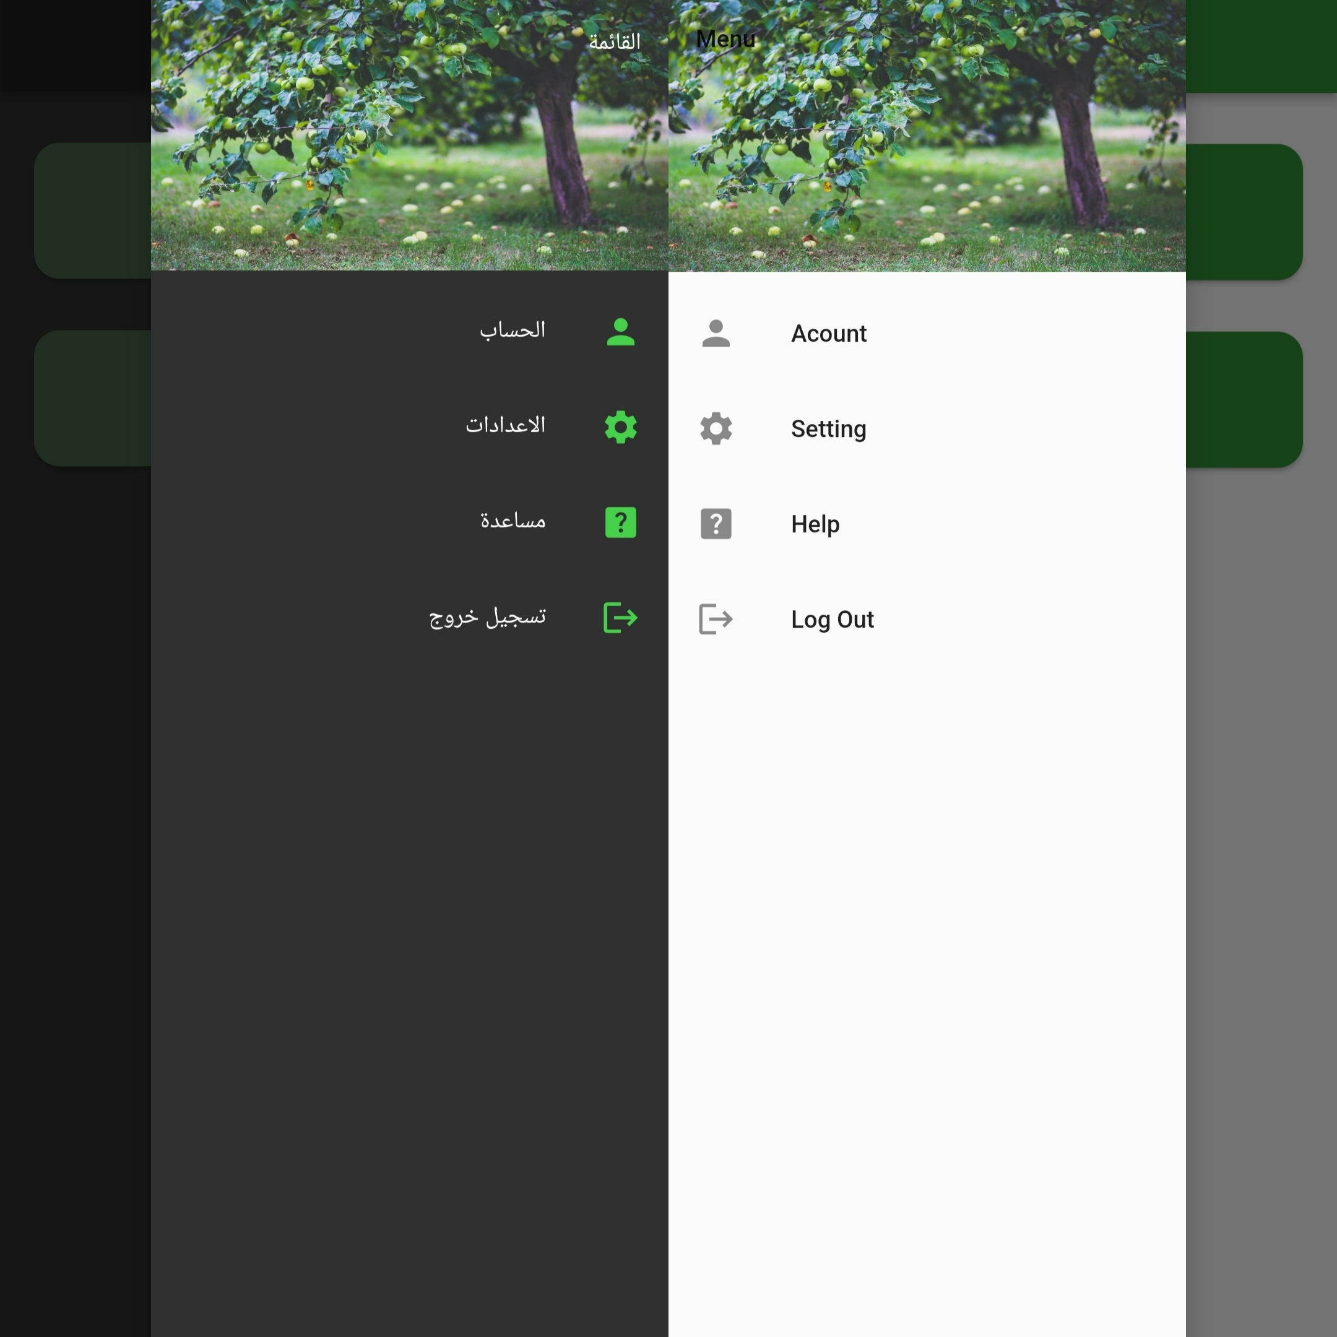
Flutter application Profile page
Profile page where the users can access their accounts, make the settings for the application, get help, or log out

Slide 30
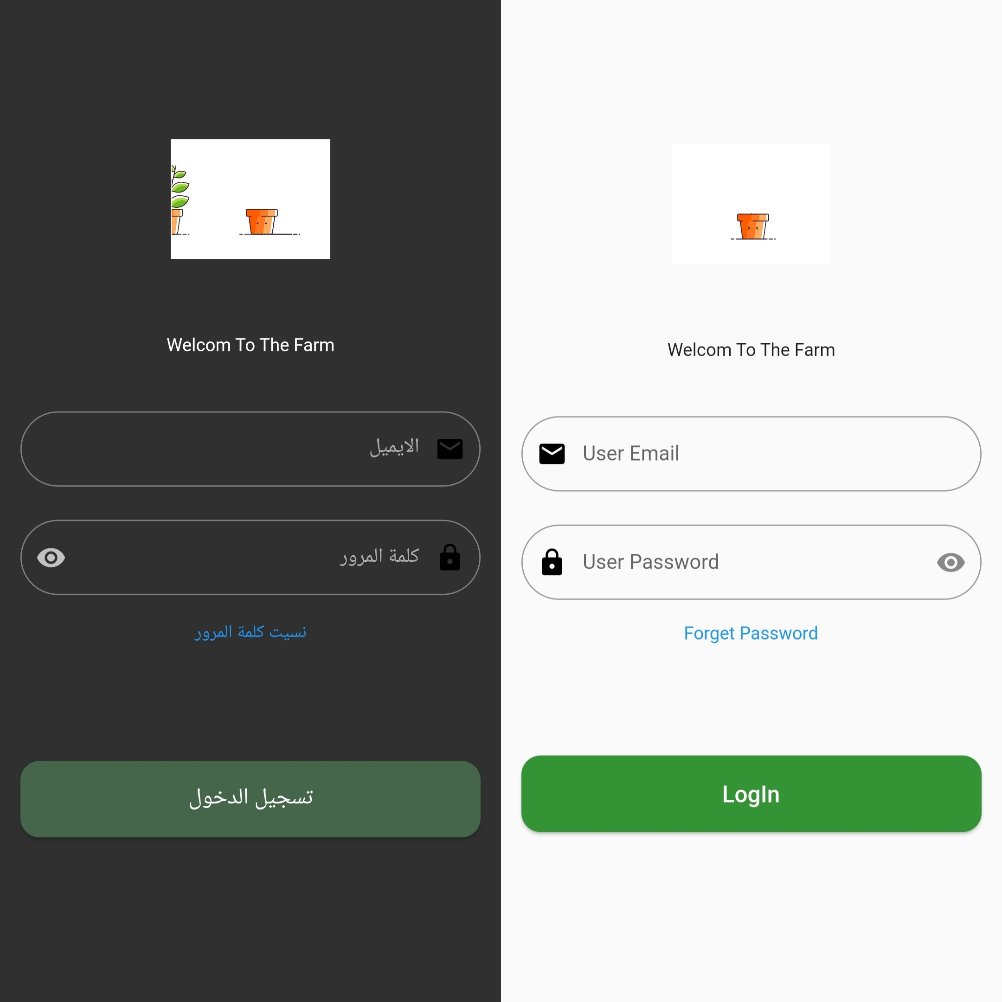
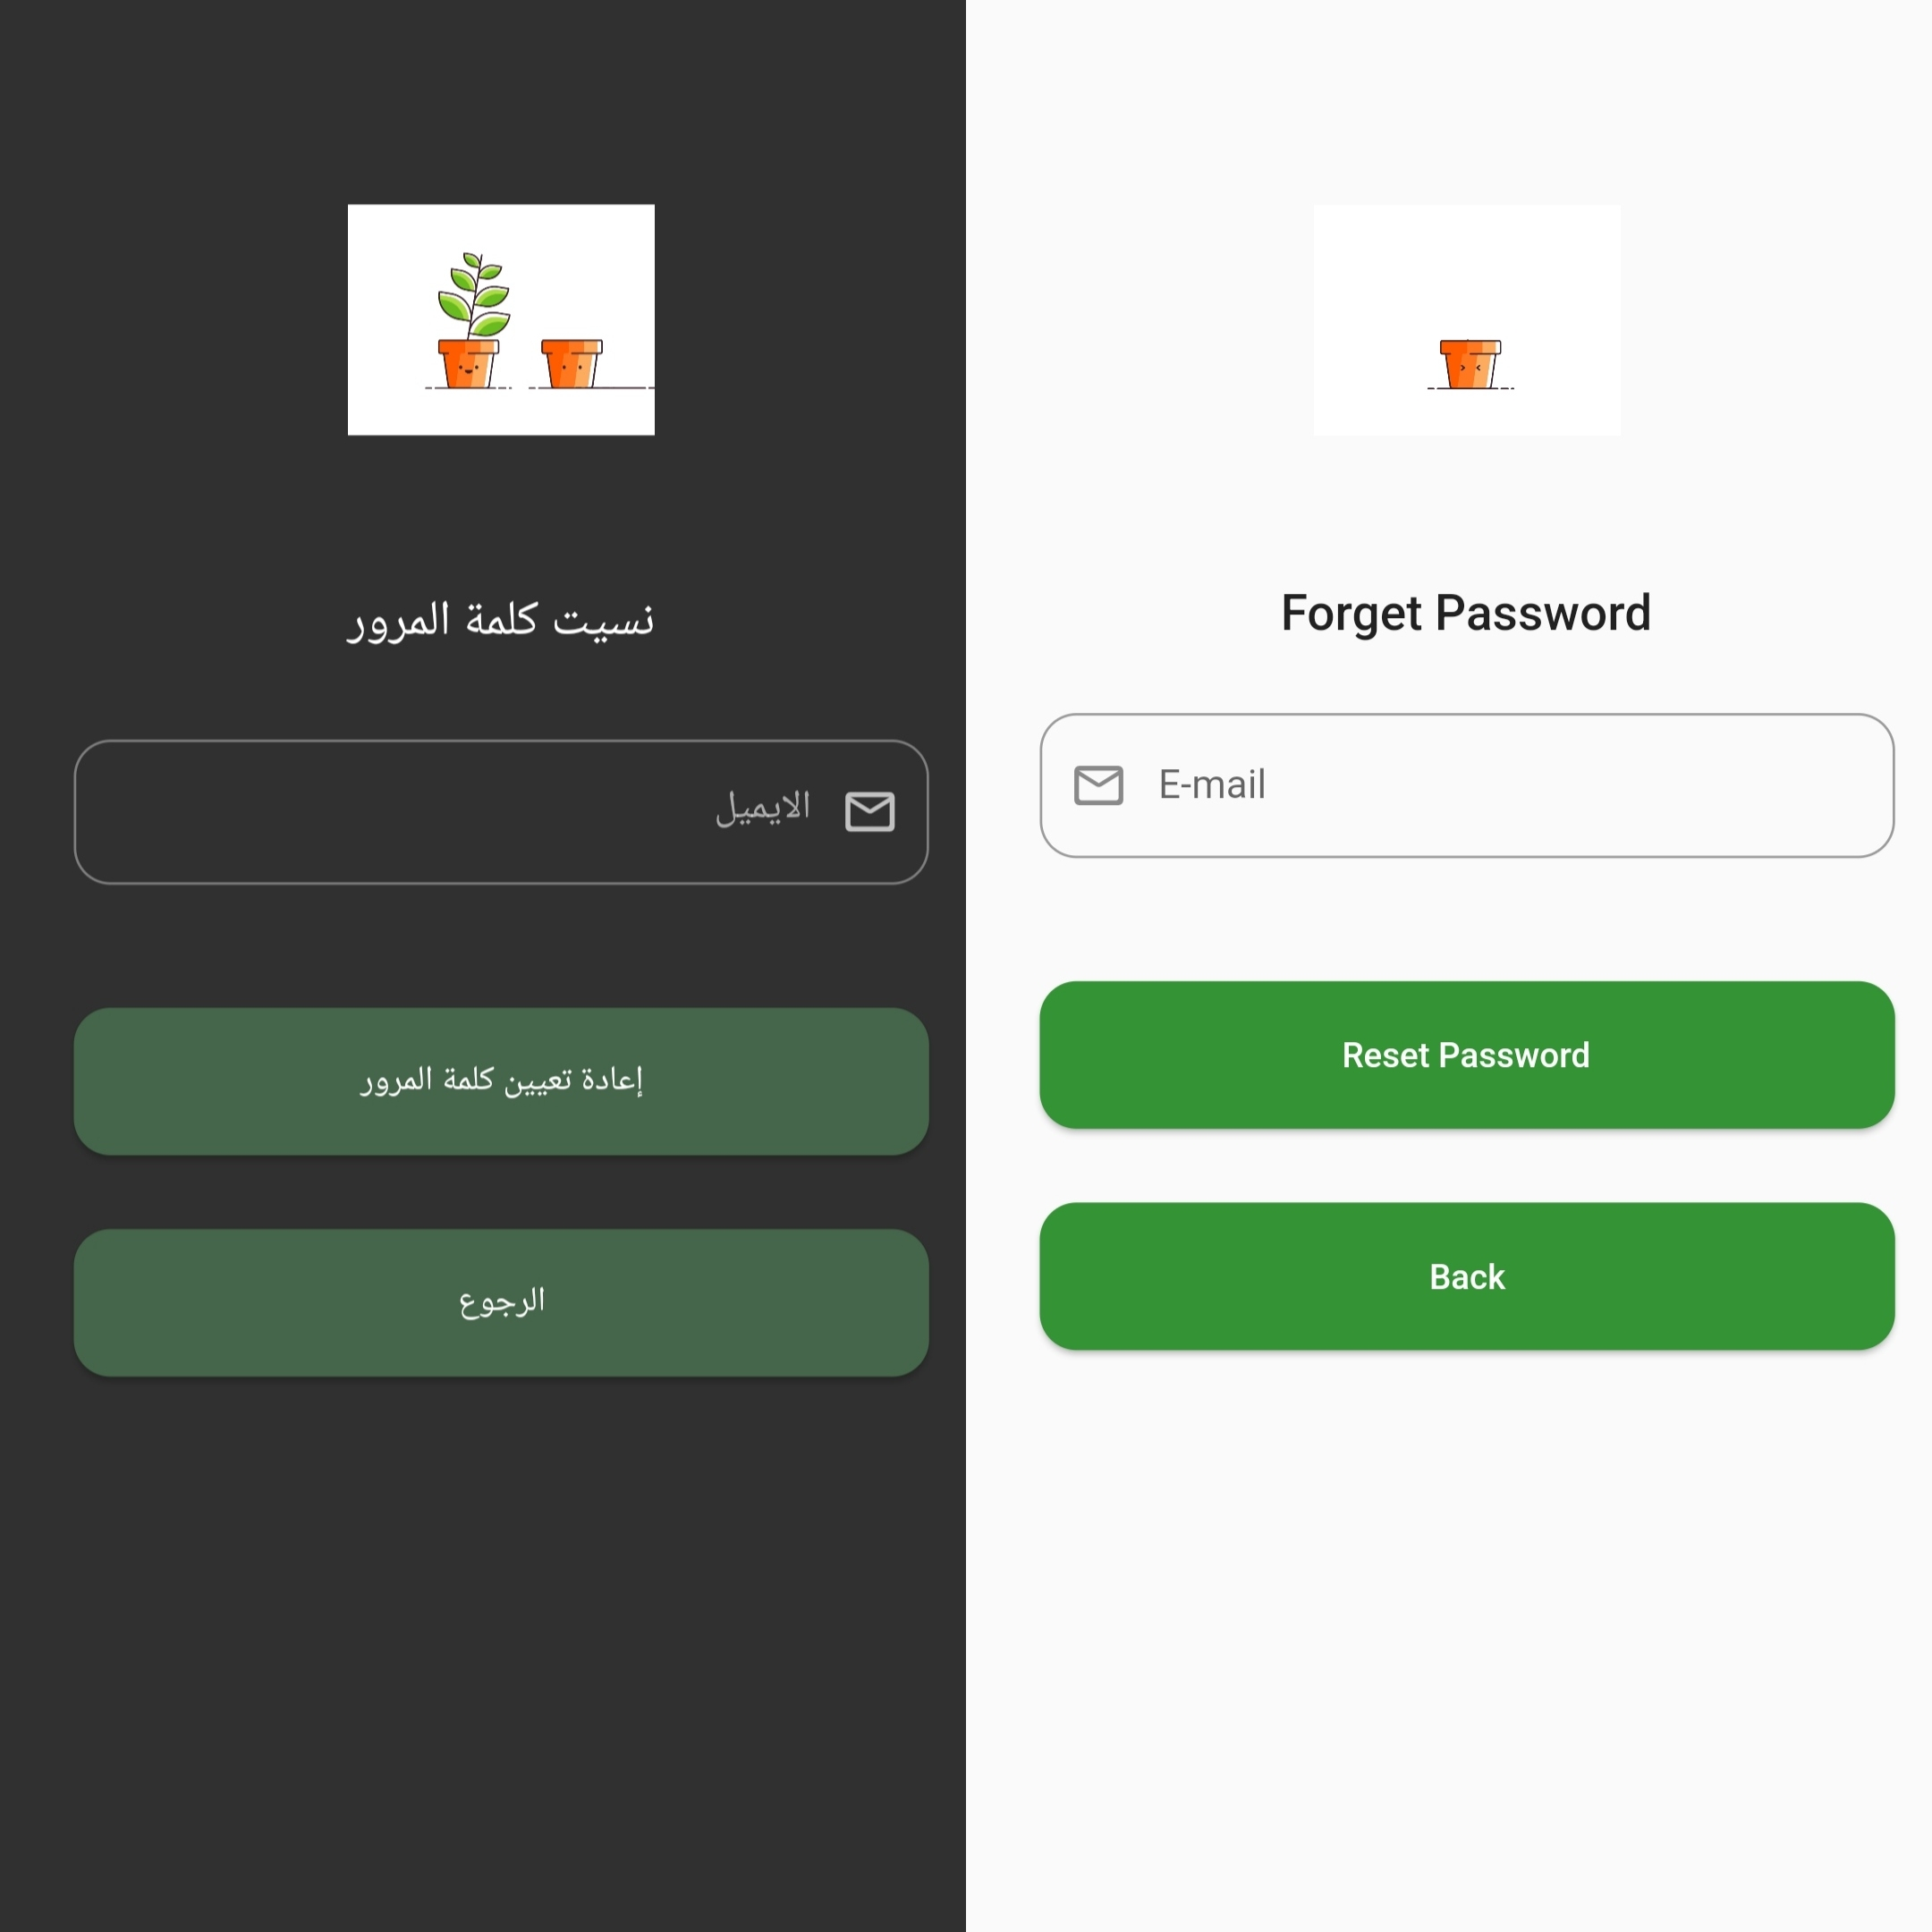
Flutter application login and forget the password page

Slide 31
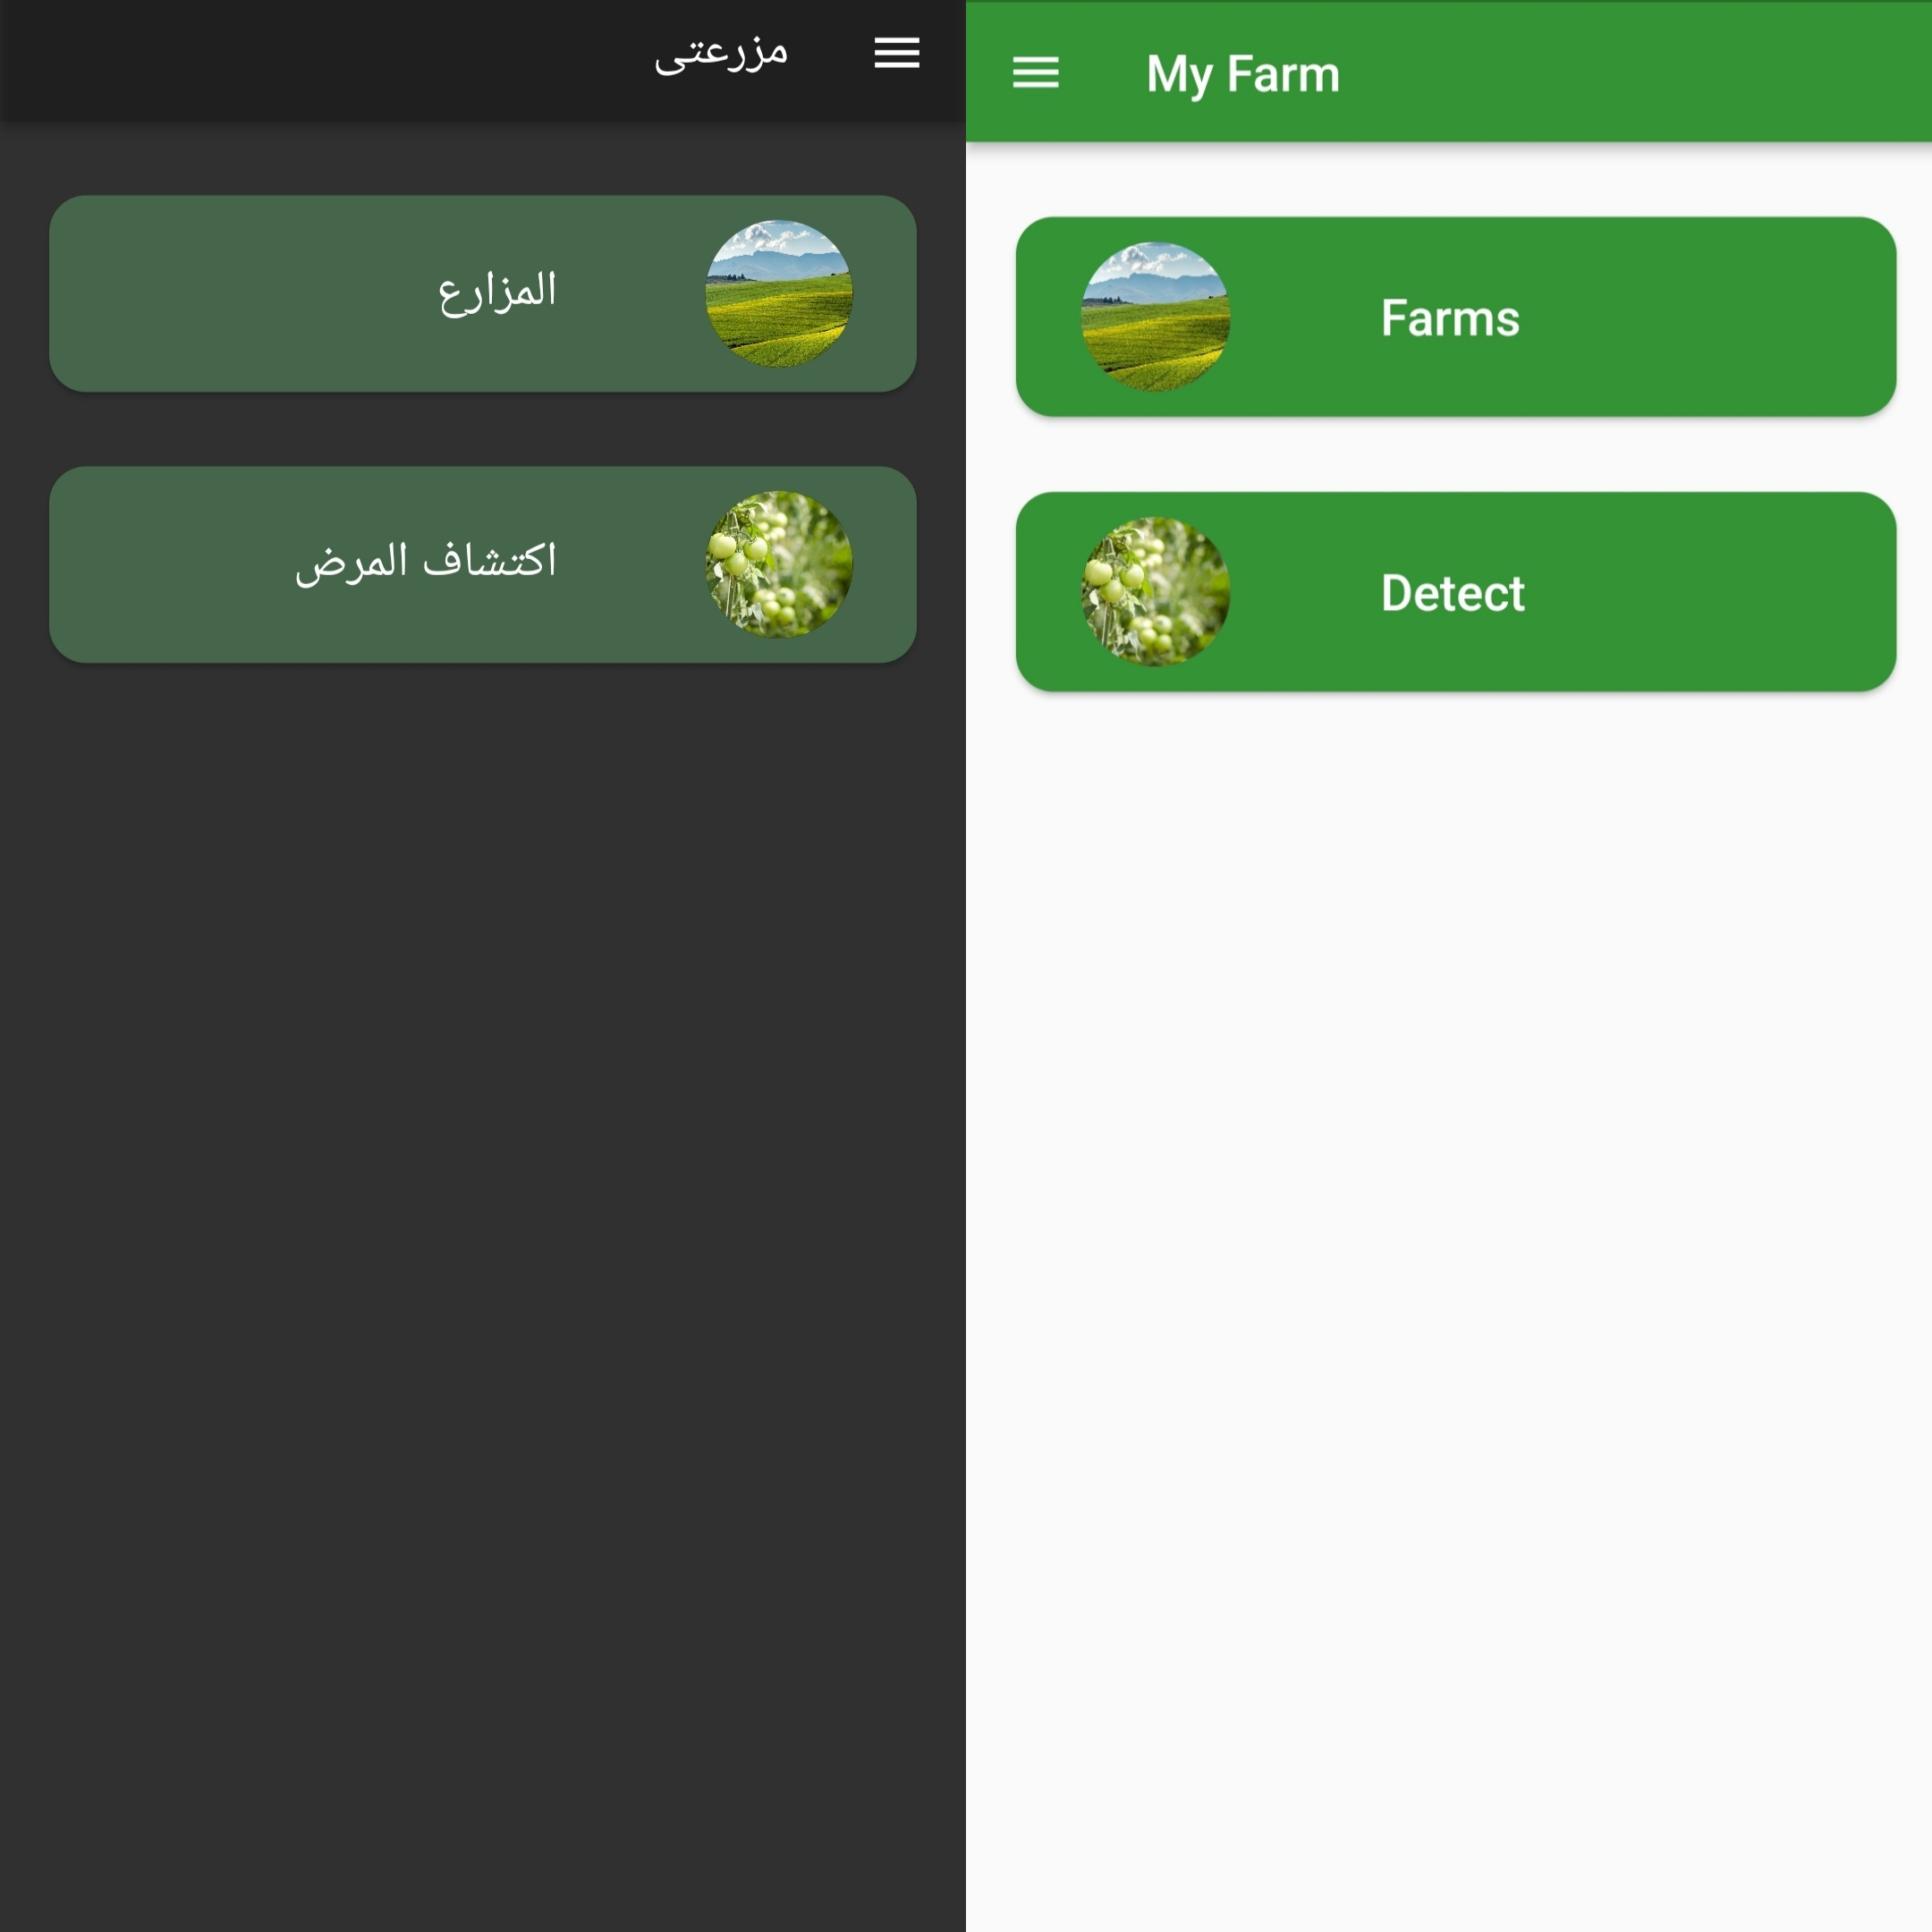
Flutter application Main page after log in
The main page contains 2 buttons,
The first one gives the user access to their farms and information about the farm.
The second button leads to a page to either capture a picture or use an already existing one for detecting a plant disease

Slide 32
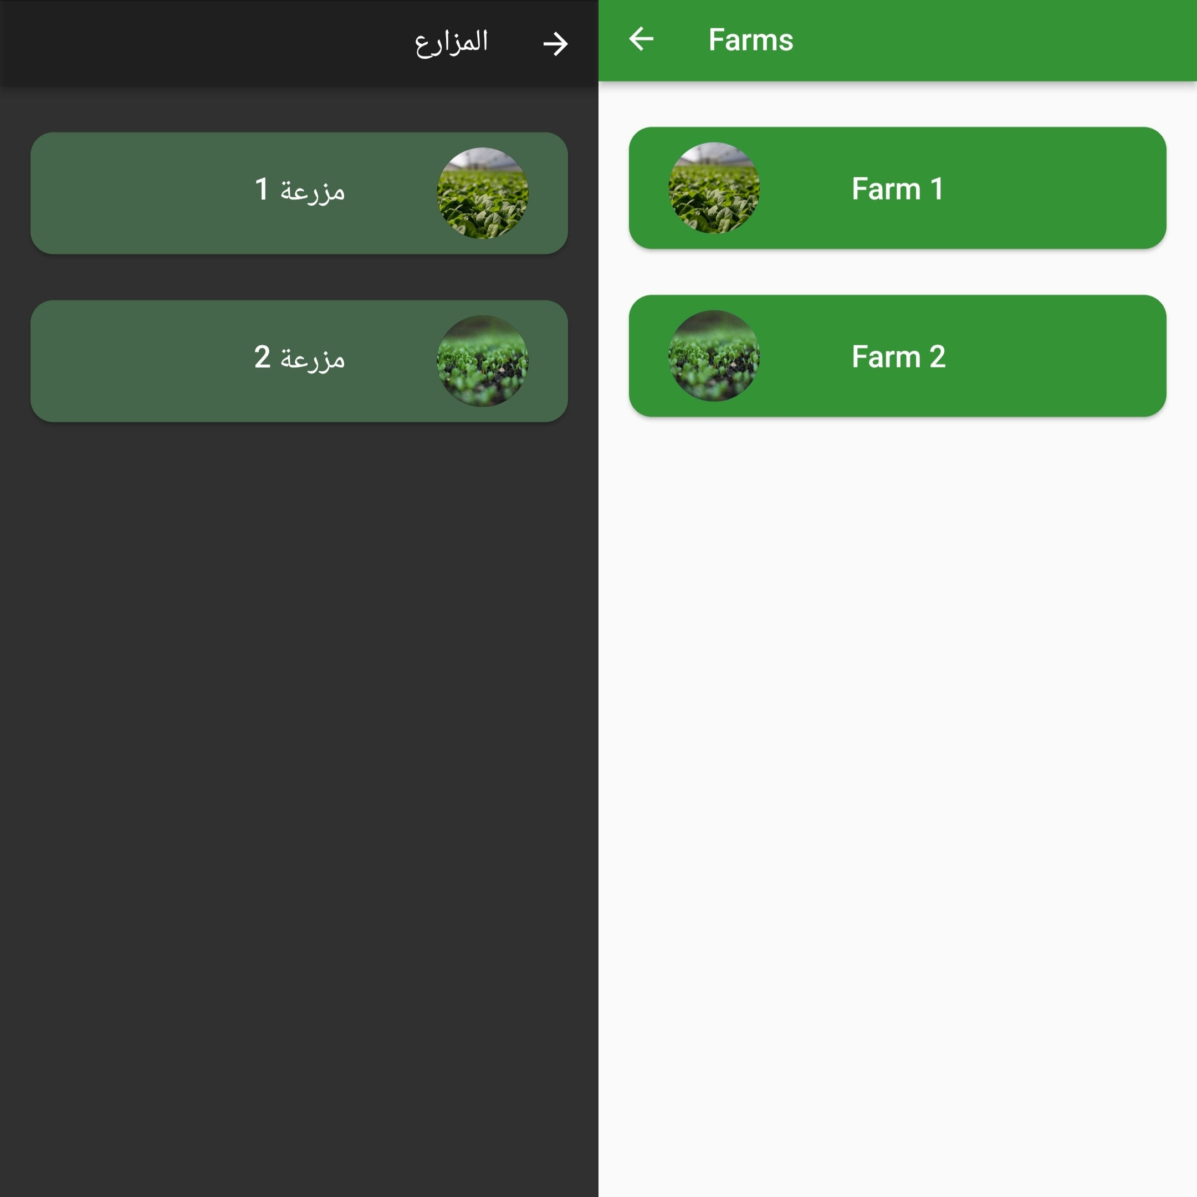
Flutter application farms feedback page
This page gives the users access to their own farms, pressing each button gives information about the farm.

Slide 33
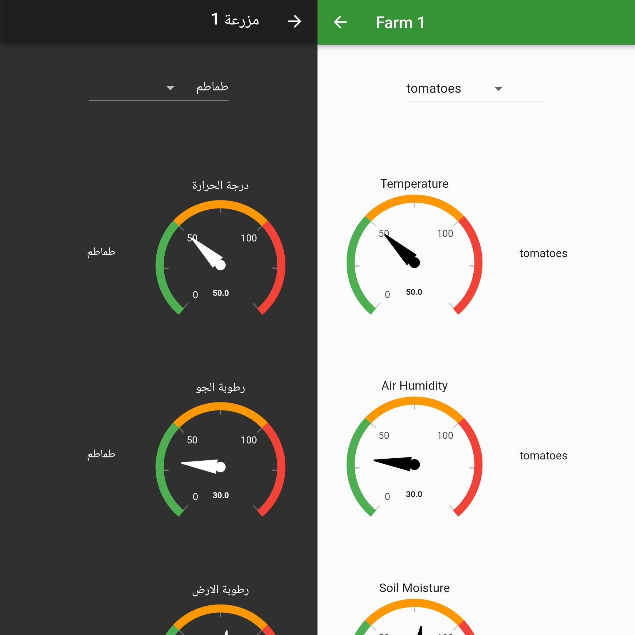
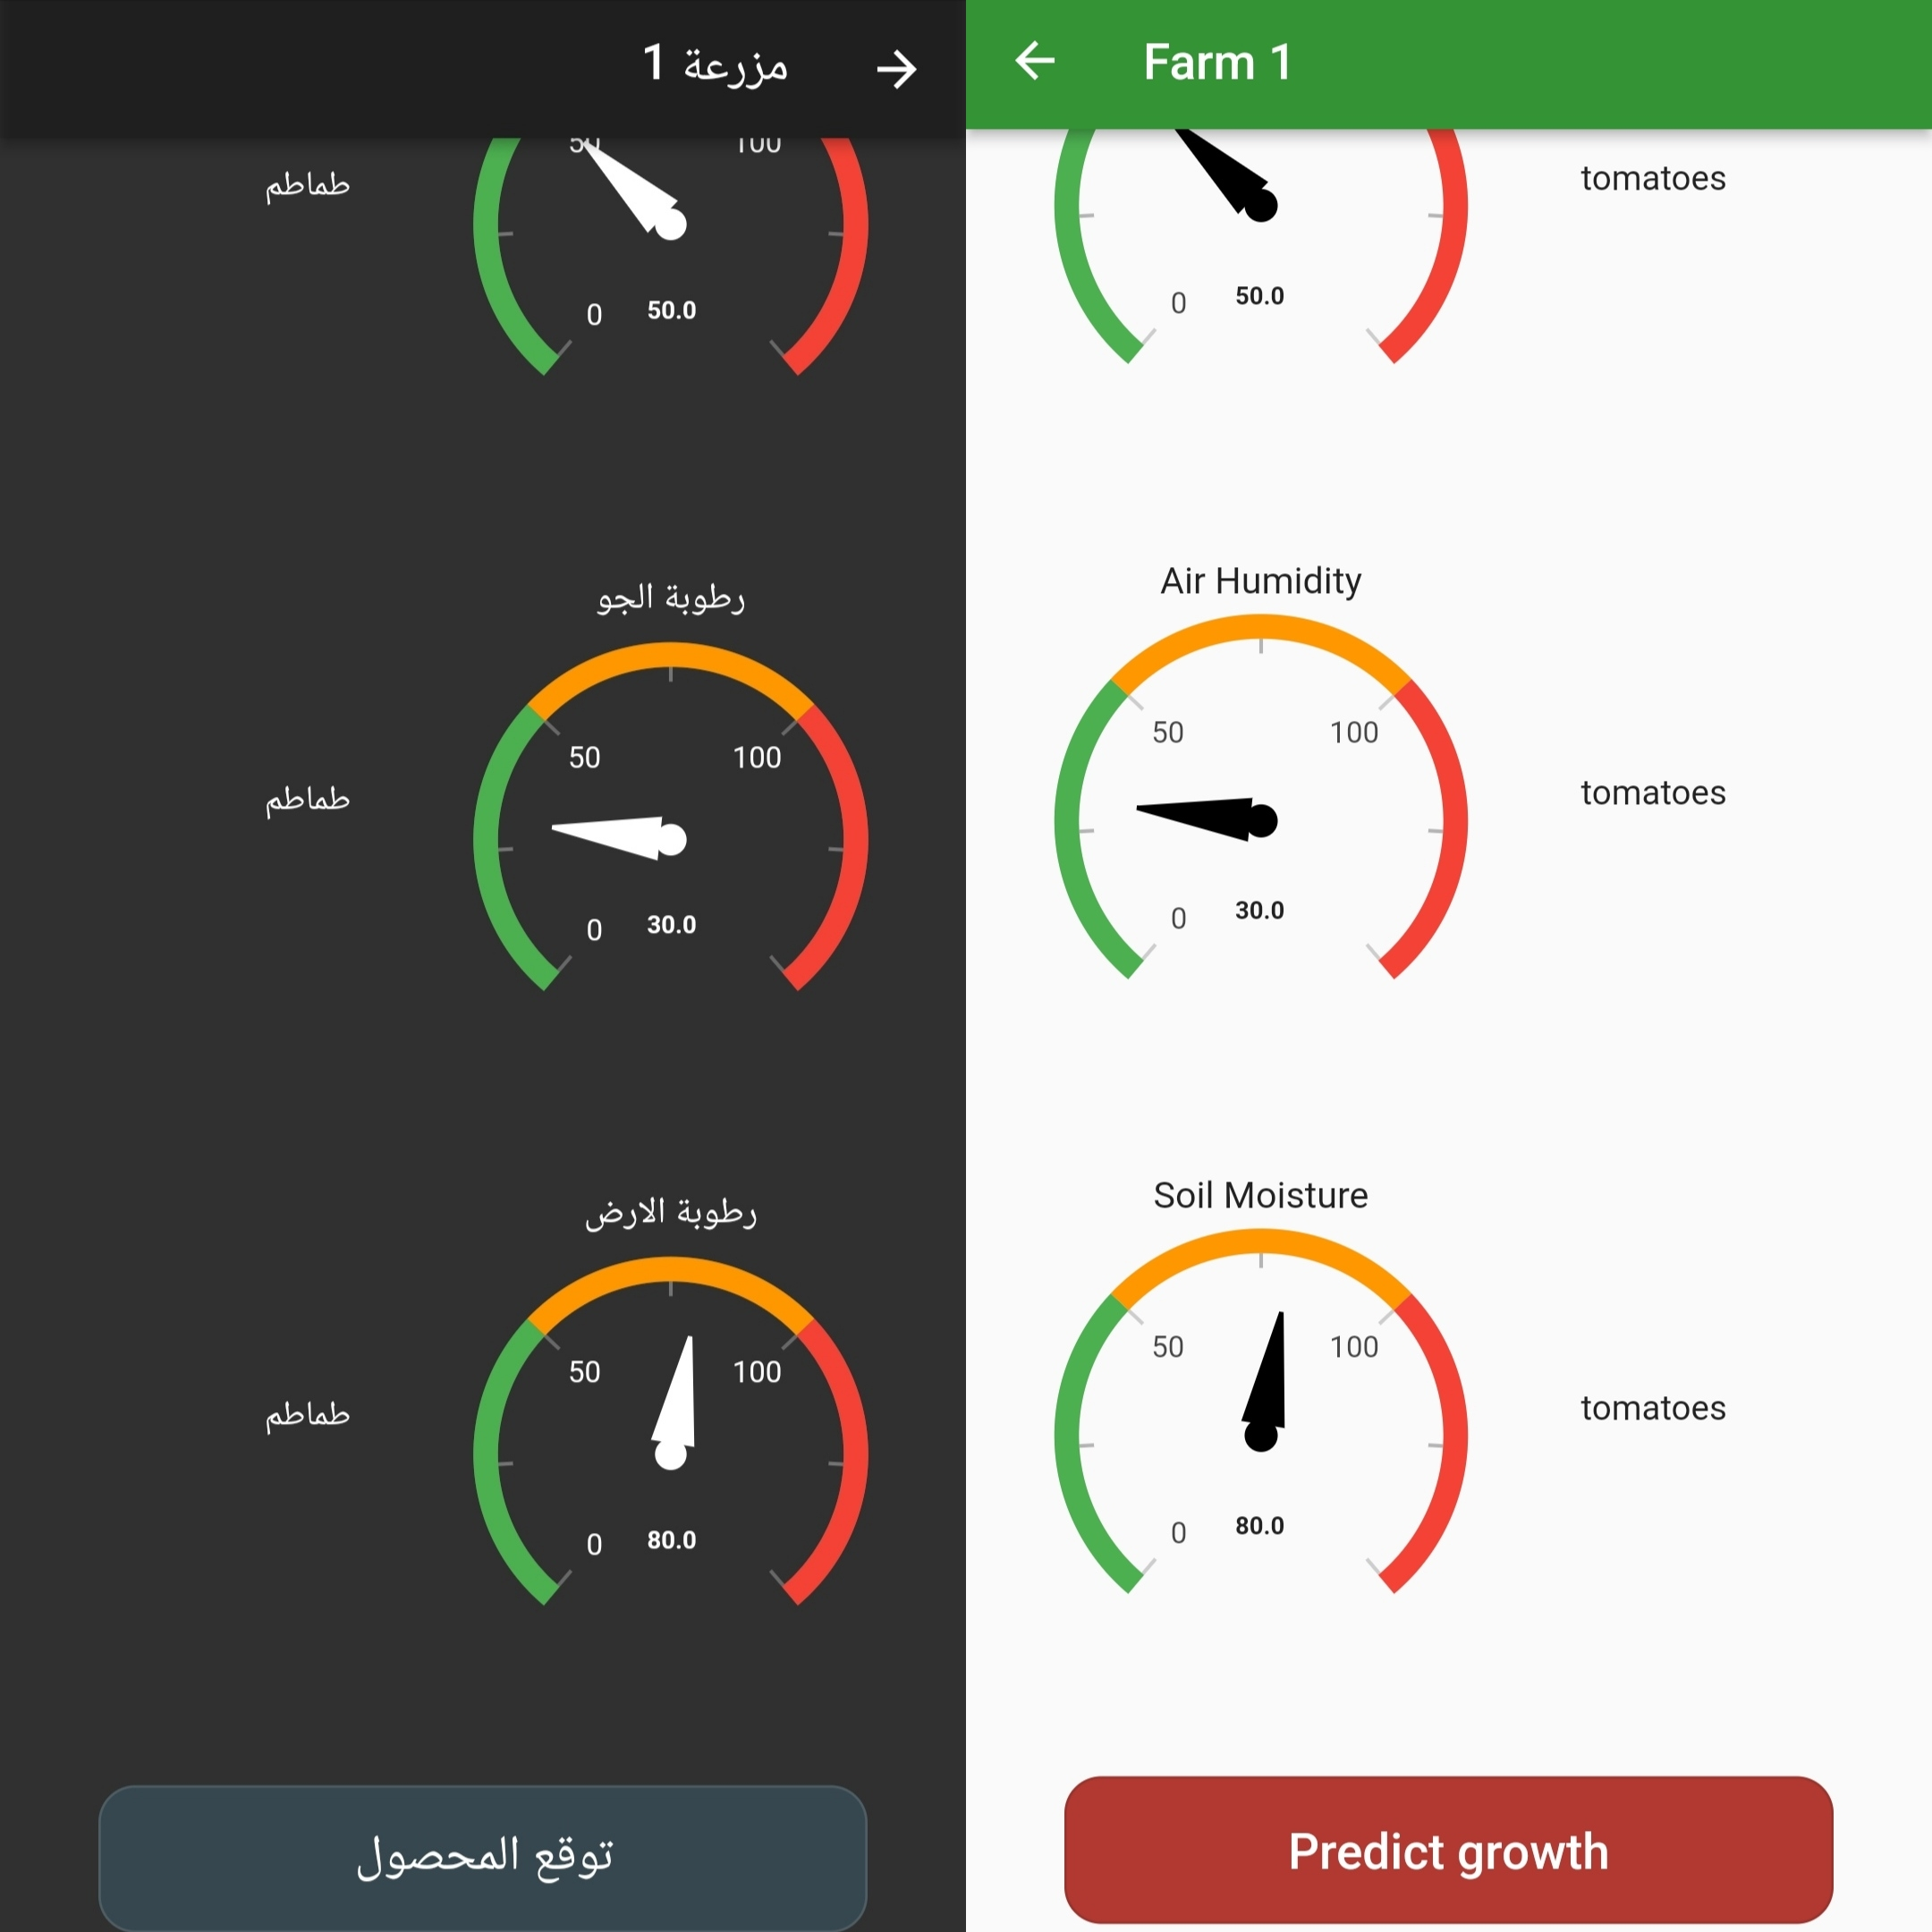
Flutter application farm feedback page

Slide 34
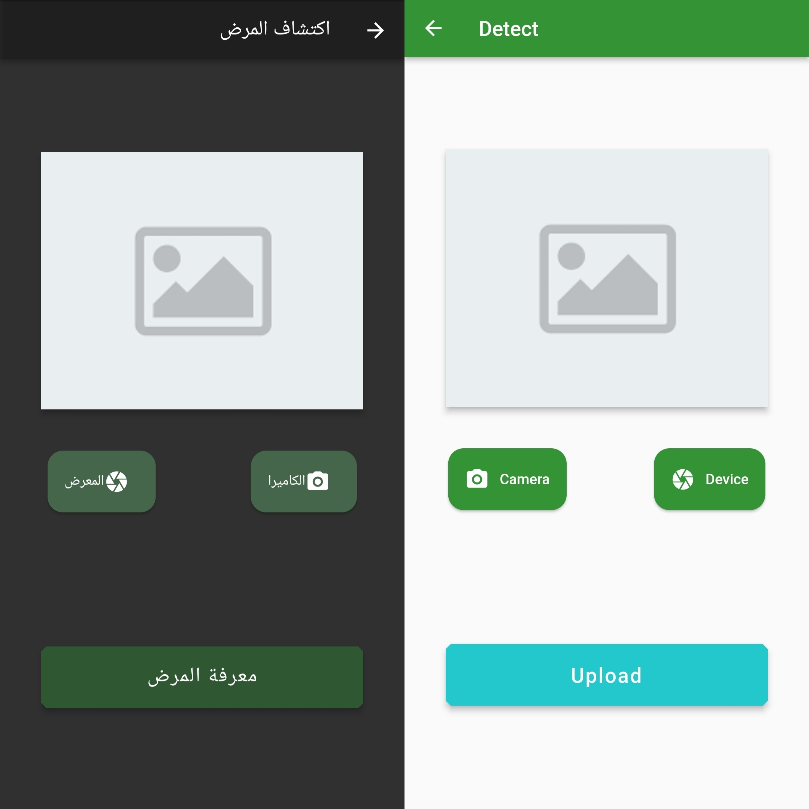
Flutter application Plant disease detection page
Page to either capture a picture or use an already existing one for detecting plant diseases

Slide 35
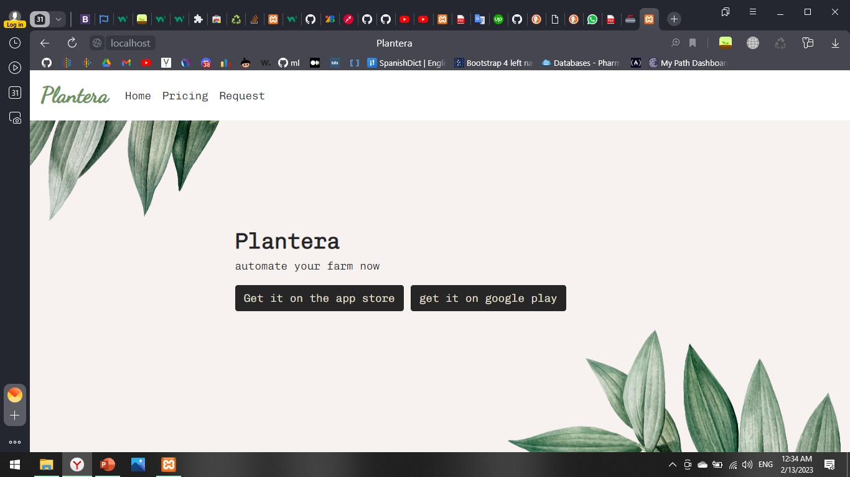
Plantera Website and land page
The home page, where the user can install the application on both the apple store, and google play

Slide 36
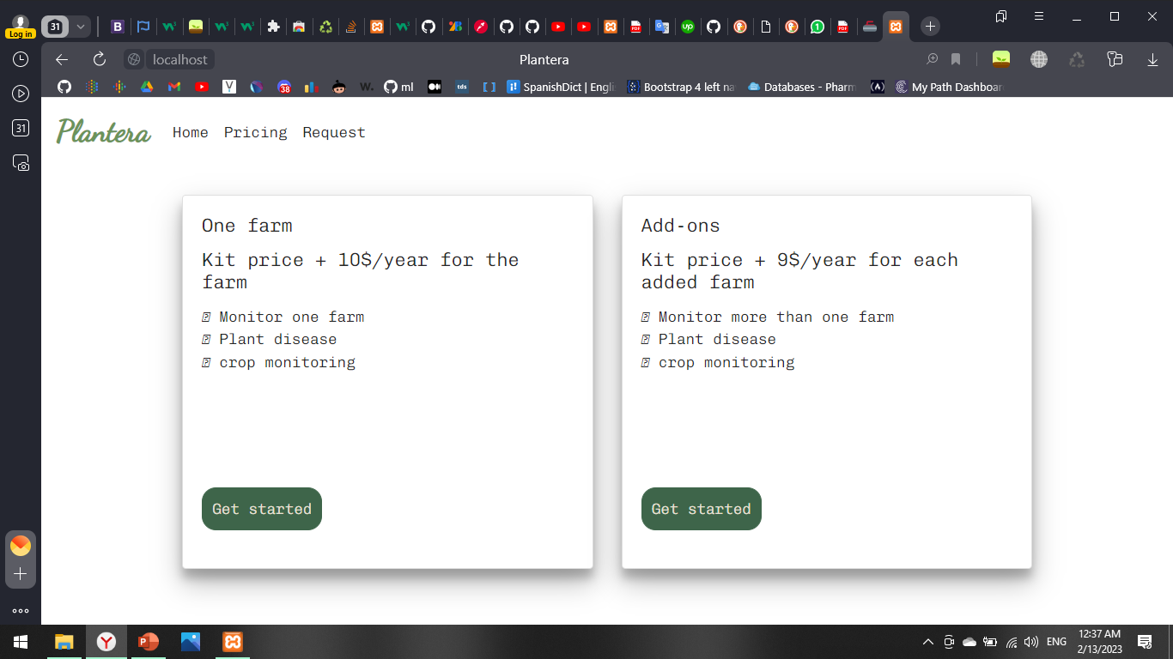
Plantera Website
Pricing page, where pricing plans are available to the user

Slide 37
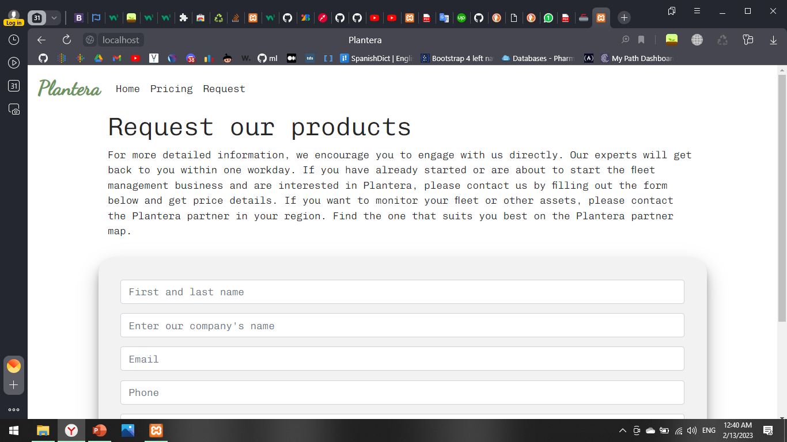
Plantera Website
Request page where the user can request to be one of our customers

Slide 38
04
Technologies and tools
In addition, What may future plans be?

Slide 39
Project Tools
Python3
Flutter
Php
Javascript
Sklearn
Arduino
Flask
Firebase
Tensor flow

Slide 40
Project timeline
Week 1 | Week 2 | Week 3 | Week 4 | Week 5 | Week 6 | Week 7 | Week 8 | Week 9
Choose the idea |  | Search for data and work with it |  |  | Work on application website and hardware |  |  | connection
 |  |  |  |  |  |  |  | APIs
 |  |  |  |  |  |  |  | Testing

Slide 41
Thank you and welcome for any questions

